Slide 1


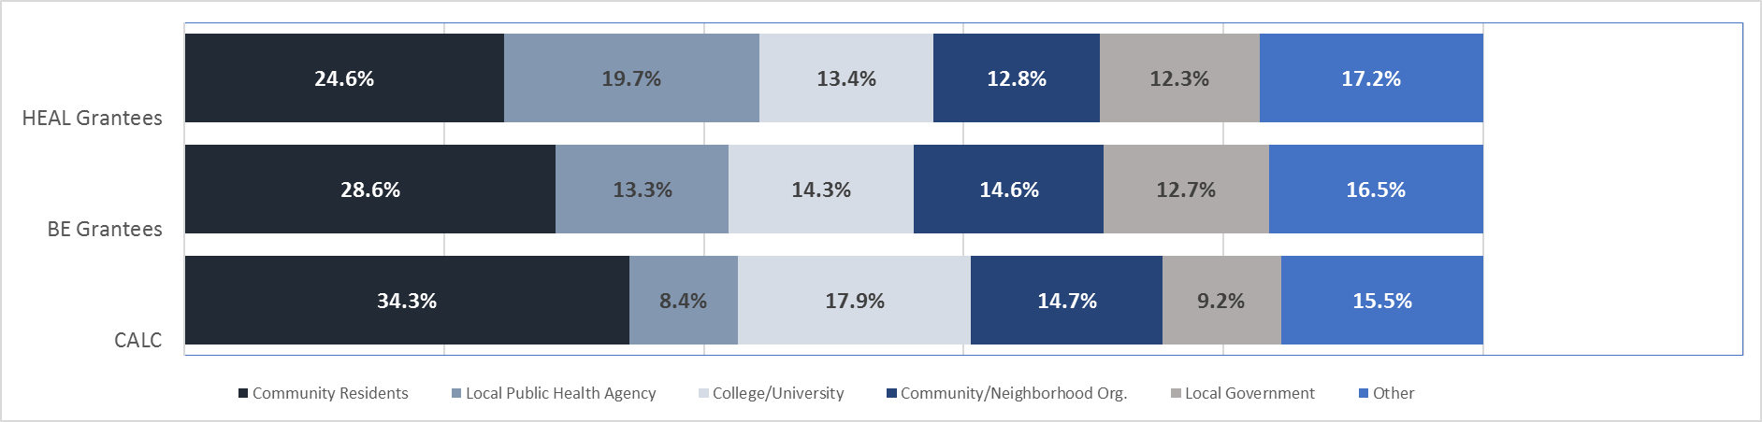
[Community Name]
Sub Title
Report Purpose: To summarize the Community Coalition’s progress towards changing policies and environments to support active living in [city] as of January 2017.
Coalition Structure & Partners-
1
251
Community Coalition
coalition
partners
Identified critical partners for policy change included representatives from _______________________________. Missing partners noted were community members of target population (e.g., ______) and representatives from Parks & Recreation and School District (including parents). “The voice of a sample school would be a powerful way to learn what it’s like running a school under the school system.”
Types of Partner:
Coalition Capacity & Effectiveness
Best:
PERFORMANCE
Focus AREA:
LEADERSHIP
Measurement: 8 members completed the CCAT to assess the effectiveness of the coalition across six categories.
Findings: Member’s rated the coalition’s effectiveness favorably; the coalition scored higher than average compared to other Built Environment (BE) and Healthy Eating Active Living (HEAL) grantees.

Slide 2







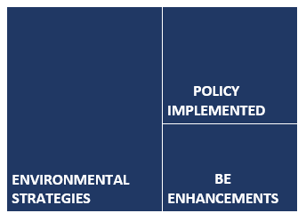
BE & Policy Change Process
Stage in policy change:
developing Advisory/Planning Committee
Communication Outreach Strategies:
On average, the coalition used more communication outreach strategies than other BE and HEAL grantees.
The most common communication outreach strategies among HEAL grantees were: print, social media, websites, and community events.
[#]
Types of Communication Outreach Strategies Used
Communication
Outreach Strategies
used
print
Social media
website
Community event
other
BE & Policy Implementation
[#]
Policy, and/or environmental changes
Total number of BE & policy changes implemented:
Coalition 6
All BE grantees (avg.): 9.3
Types of BE changes implemented varied by site & reflected the specific nature of each coalition’s efforts.
Primary BE change implemented by the coalition:
Environmental strategies prioritized/recommended
Among all BE grantees, most common changes included:
Strategies prioritized/recommended = 18
Coalition plans adopted = 5
BE enhancements = 4
BE policies implemented = 1
[#]
[#]
[#]
Early Findings & Highlights
Add your own bullet
Add your own bullet
[Logo or other footers here]

